Slide 1
Movie Recommendation System on Big Data
Internal Guide : Dr. T. Adilakshmi
Anuvik .T – 1602-18-733-070
Rahul .L – 1602-18-733-089

Slide 2
INTRODUCTION
Recommender systems are being used extensively in the modern digital age as mammoth of user data is available in the contemporary private databases.
The existing recommender systems are built using algorithms like K-means, Collaborative filtering etc.
In this study, we used CURE Algorithm for clustering the data. Pre-eminent clustering algorithms are either bent towards Spherical shape clusters with close sizes or sensitive with respect to others.
CURE Algorithm helps in introducing another method which extrapolating every cluster by fixing the number of points which are obtained from random points in the cluster which with the help of precise fraction are directed towards the cluster centre.

Slide 3
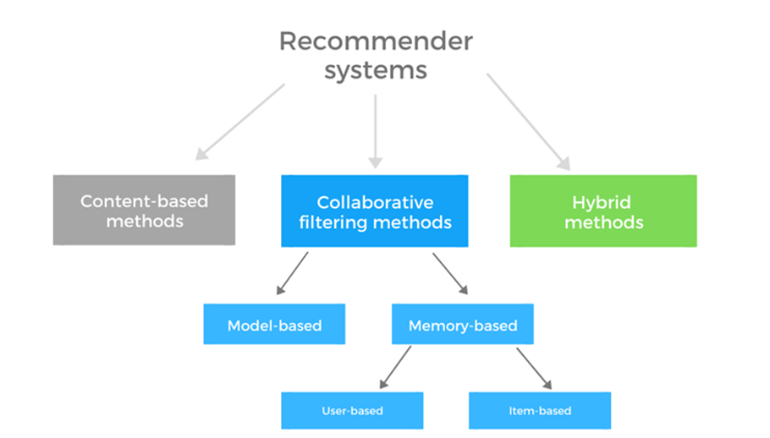
Goals and Types of Recommender Systems
1.User-Experience Customization: Enhances the hands-on experience for the user by analysing the user’s behaviour and preferences.
2.Optimum Item Search: Splits the items based on the parameters.

Slide 4
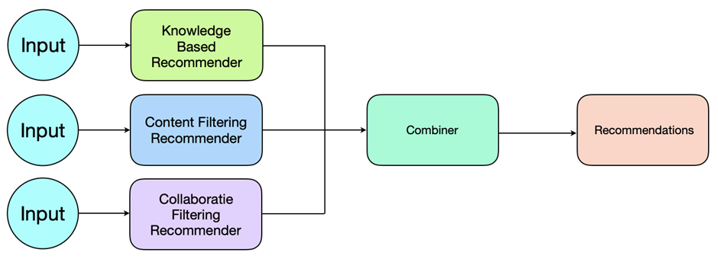
TYPES OF RECOMMENDATION
Content-Based Recommendation System:
In this methodology, the system suggests user’s preferred item based on their selection criteria by using similarity. It suggests items based on their existing functionalities. It recognizes the closeness among the items on the basis of content.
Collaborative Based Recommendation System:
This methodology suggests items based on collaboration of users which are luminous methods used in market.
Hybrid Recommendation System:
Hybrid Recommendation System is an amalgamation of Content and Collaborative based recommendation systems.
We used Hybrid recommendation system in our project to recommend movies to user.

Slide 5
METHODOLOGY- CURE ALGORITHM
The Clustering Algorithm used is Clustering Using Representatives (CURE). The pivotal reason for opting this Algorithm is its compatibility with Big Data. The Crux of this algorithm is to represent a particular cluster in terms for few Representative points, there by scaling the large dataset into few representative points helps in handing gigantic amount of data.
Also CURE incorporates a compression factor that reduces the cluster size to some imaginary level and detects anomalies, thereby providing effective clusters. This Algorithm can be parallelized using distributed environment and process the application for Big Data.

Slide 6
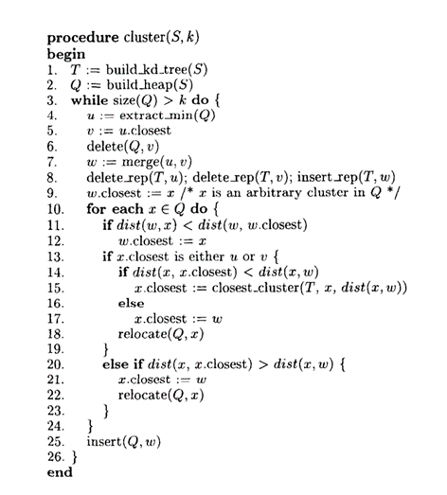
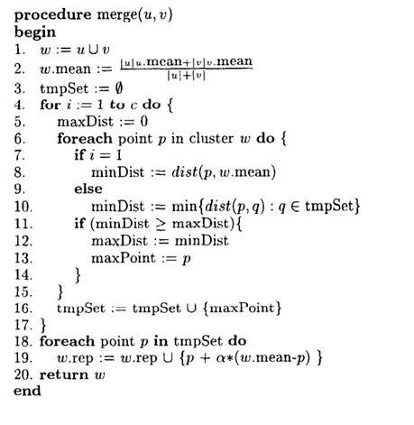
WORKING AND MERGING OF CURE
FIG . WORKING OF CURE
FIG . MERGING OF CURE

Slide 7
Content-Based Filtering & Hybrid Recommendation Engine

Slide 8

Clustering Movies
For the second phase of project, we considered a 1000 Users Movies Dataset.
Here the 10,381 movies are clustered using the CURE algorithm.
We obtained the optimal number of desired clusters as 35 using the WSS scores of the data thereby finding the elbow point.
Previously we worked on the 100 users dataset which is executed in local and non distributed environment.
For 1000 users we scaled up the process of execution using distributed environment called Databricks.

Slide 9
Clustering Users
After successfully clustering the movies into the optimal number of clusters, the next part of our algorithm is to cluster users.
The 1000 users are clustered into 24 User clusters using the same CURE algorithm.
The movies are clustered based on the tag relevance values where as, the users are clustered based on ratings given by the user
After clustering the users and movies we pass this information to the recommendation engine to obtain the recommended movies to the given user.

Slide 10
DATA BRICKS AND SPARK DATAFRAME
DATABRICKS
Databricks is a centralized and open-source platform to process all the data. It provides an environment for interaction and scheduling of workloads of data analysis for data analysts, data engineers and data scientists.
SPARK DATAFRAME
Firstly, to ensure parallelization the data frame of the movie’s dataset needs to be converted into spark data frame. The spark data frame internally divides it into multiple partitions, where different node are mapped to partition for handling. In this way the parallelization is achieved, parts of the data frame is computed parallelly and the results are merged to give the final output.

Slide 11
Recommendation Engine

Slide 12
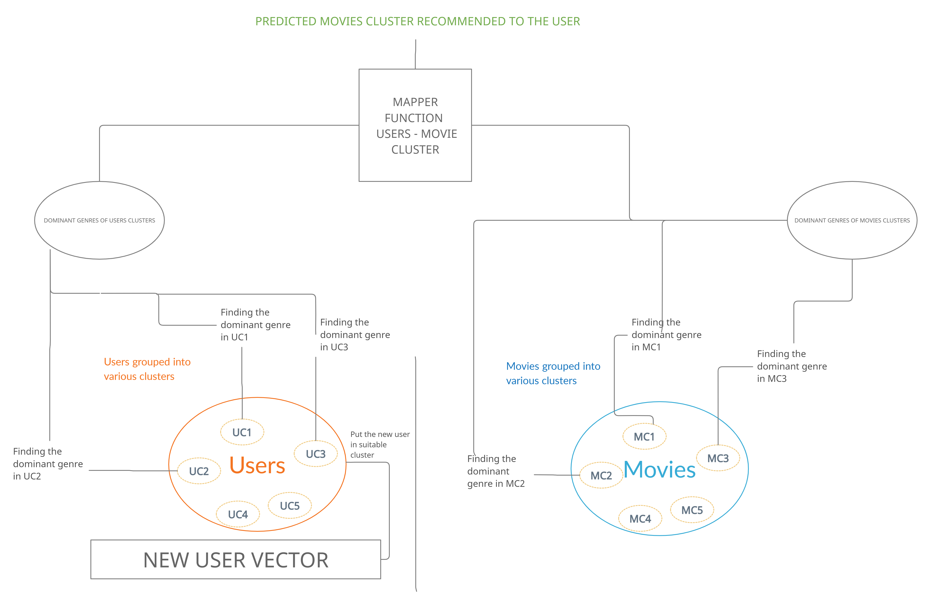
Workflow of the Recommendation Engine

Slide 13
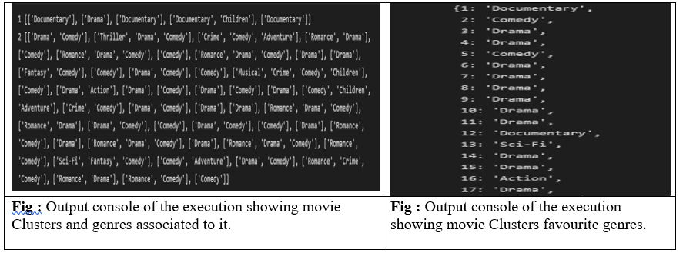
RESULTS
Content Based Filtering on the movies Clusters
The new model that we proposed uses content-based filtering of movies based on tag genome dataset.
All the similar movies are clustered using the CURE Algorithm.
The movie clusters obtained consists of ID’s of the movies belonging to the cluster.

Slide 14
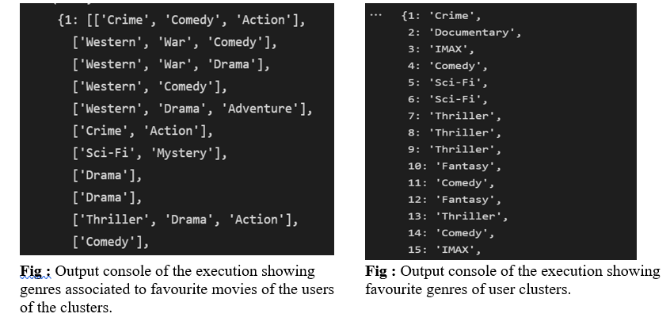
RESULTS
Content Based Filtering on the Users clusters
The user clusters obtained consists of ID’s of the movies belonging to the cluster.
We selected the movies which are favourite to the users i.e. ratings >= 3.

Slide 15
Thank You

